Slide 1


Sarvajanik Education Society Sarvajanik College of Engineering & Technology, Surat. Master of Computer Applications Academic Year: 2023– 24
A Project On
“Student Management System”
Presented By
JHA SHUBHAMKUMAR (ET23MTCA020)
SHAH RUCHITKUMAR (ET23MTCA060)
SOLANKI KHUSHALKUMAR (ET23MTCA062)
M.C.A. I Sem. 1
Under the Guidance of
Prof. Preksha Parmar

Slide 2
Agenda
Project Abstract Objective System Description (Technology Used) Database Design / File System (Table Design) Diagram (Use Case Diagram, Activity Diagram) Screen Shorts Limitations References

Slide 3
Project Abstract
Student Management System is application developed for managing student data in school, colleges and institutes. In this system admin is super user who can manage all operations like Manage course, manage Student, Generate login ID & Password ,fees Payment etc. The system provides a platform for teacher and student to view the information in the system.

Slide 4
Objective
Main Objective of the Student Management System is to go with computerized system, instead of old fashioned manual process. As compared to old process this system help to increase Sustainability. In this system admin is super user who can manage all operations related to teacher and students.

Slide 5
System Description
Software Requirement | Dev C++, Turbo C
Hardware requirements | Processor : Minimum 2 GHz Hard Drive : Minimum 64 GB or More Memory : 4 GB or Above
Operating System | Microsoft Windows 11

Slide 6
File System (Table Design)
Course | Teacher | Student
Course_Id | Teacher_id | Enrollment_no
Course_Name | Teacher_name | Student_name
Subjects | Date_of_joining | Email_id
 | Mobile_no | Mobile_no
 | Email_id | Address
 | Salary | Date_of_birth

Slide 7
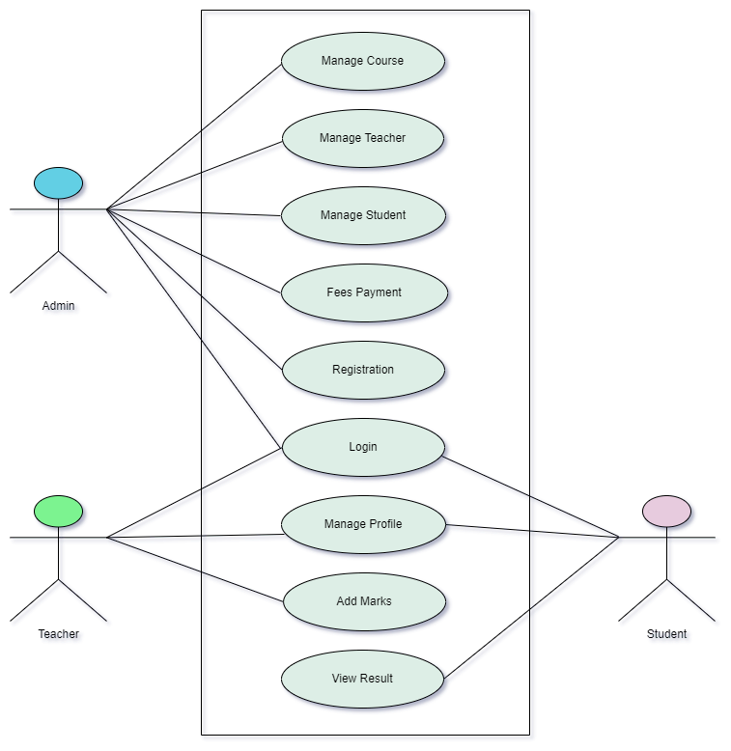
Use Case Diagram

Slide 8
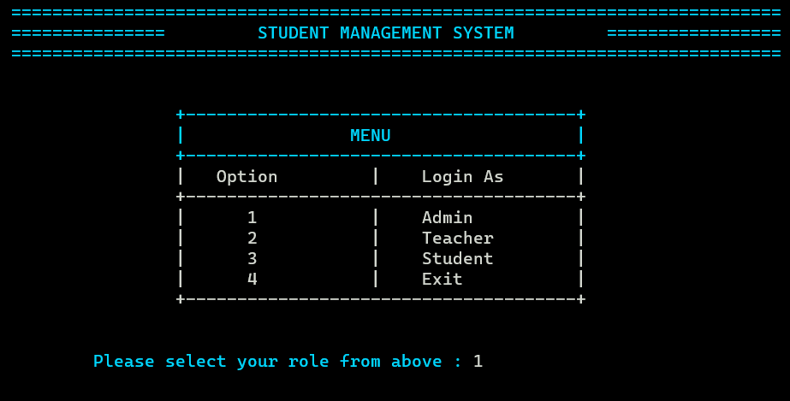
Screen Shorts

Slide 9
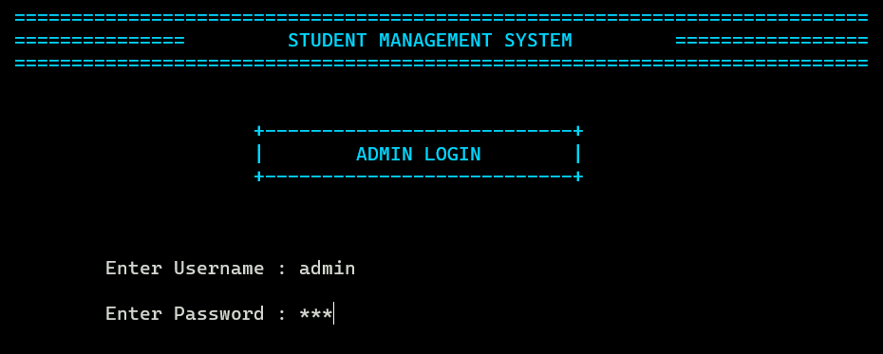
Screen Shorts

Slide 10
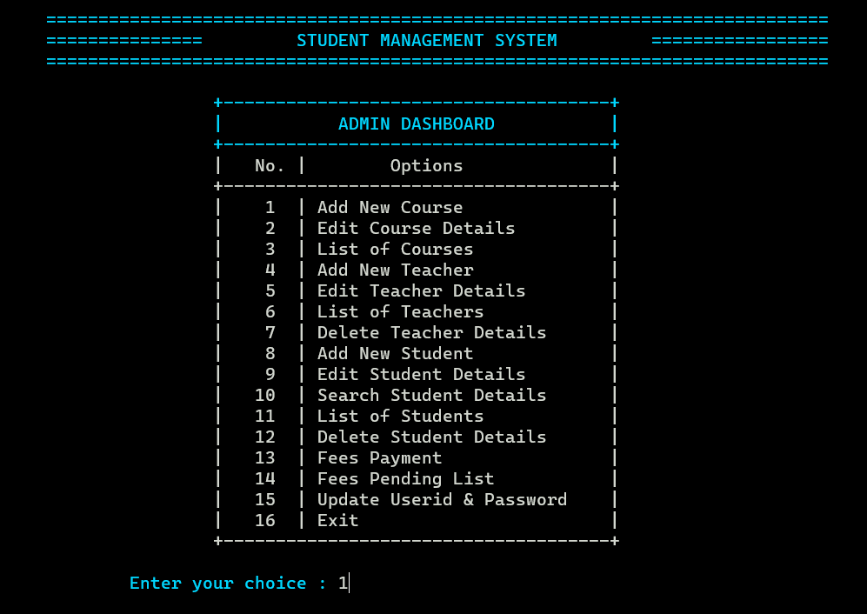
Screen Shorts

Slide 11
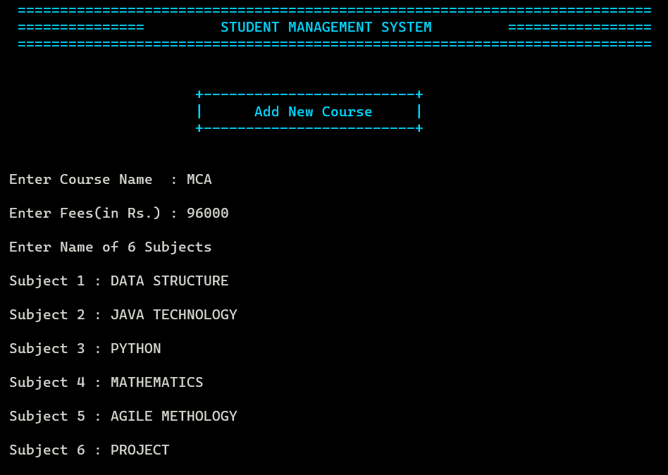
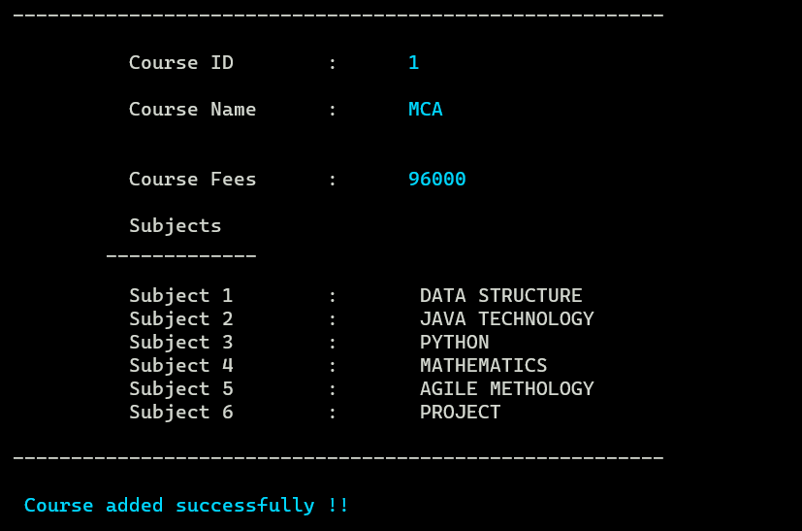
Screen Shorts

Slide 12
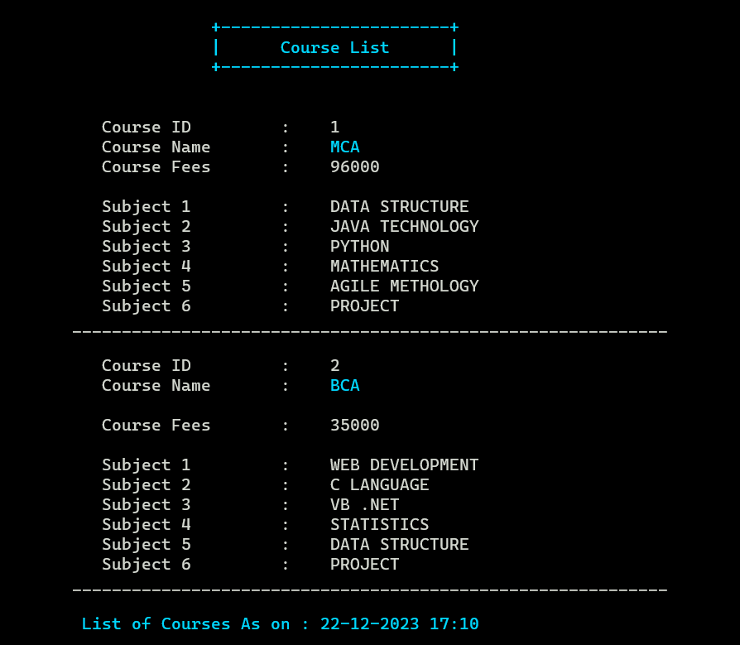
Screen Shorts

Slide 13
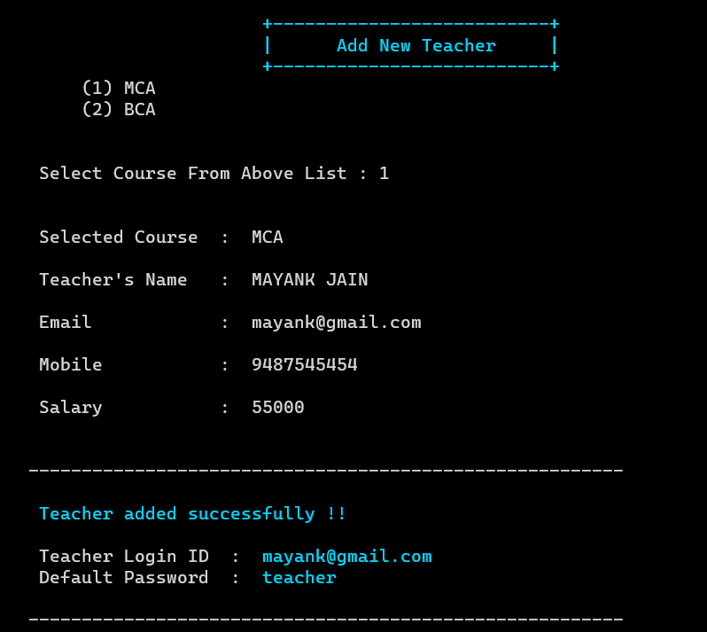
Screen Shorts

Slide 14
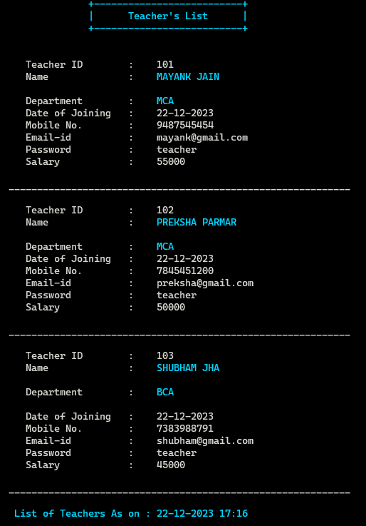
Screen Shorts

Slide 15
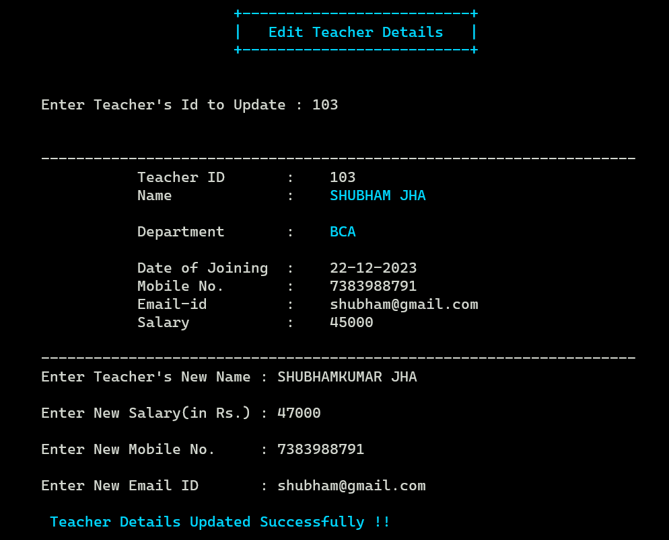
Screen Shorts

Slide 16
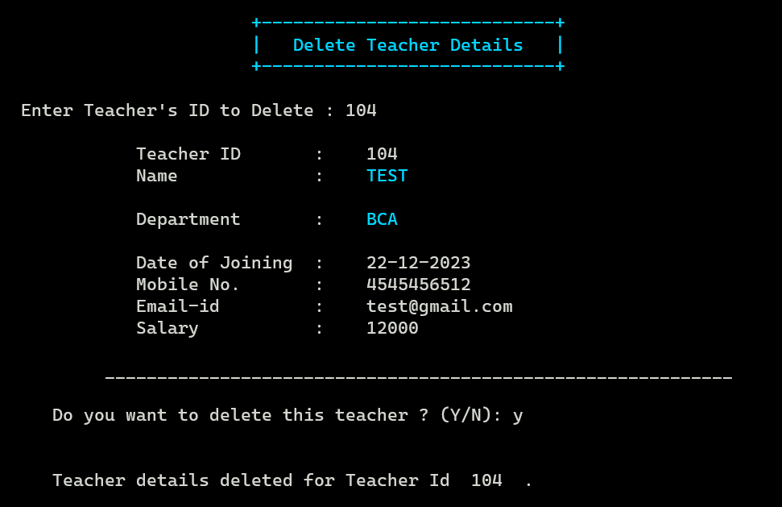
Screen Shorts

Slide 17
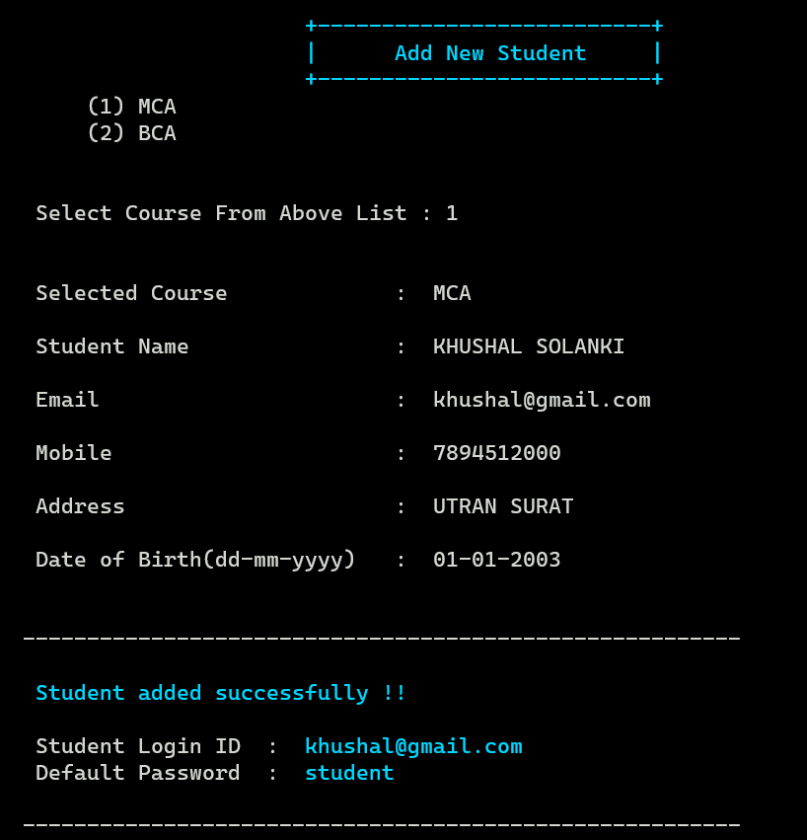
Screen Shorts

Slide 18
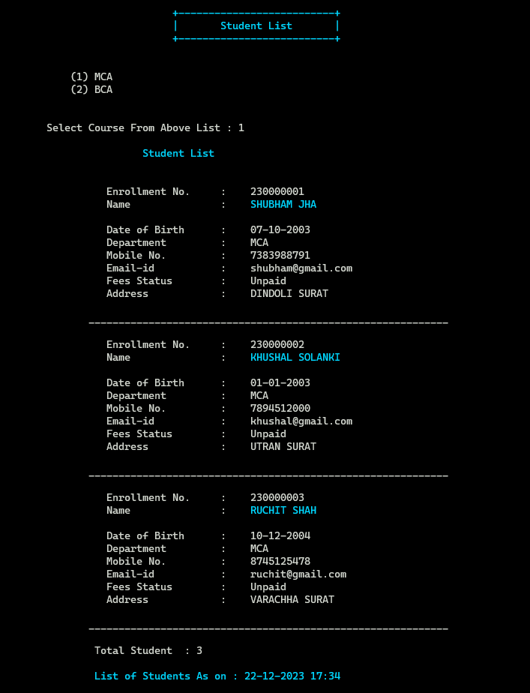
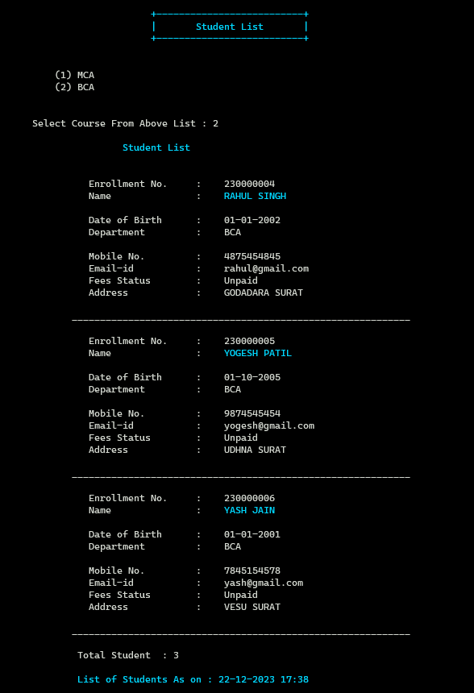
Screen Shorts

Slide 19
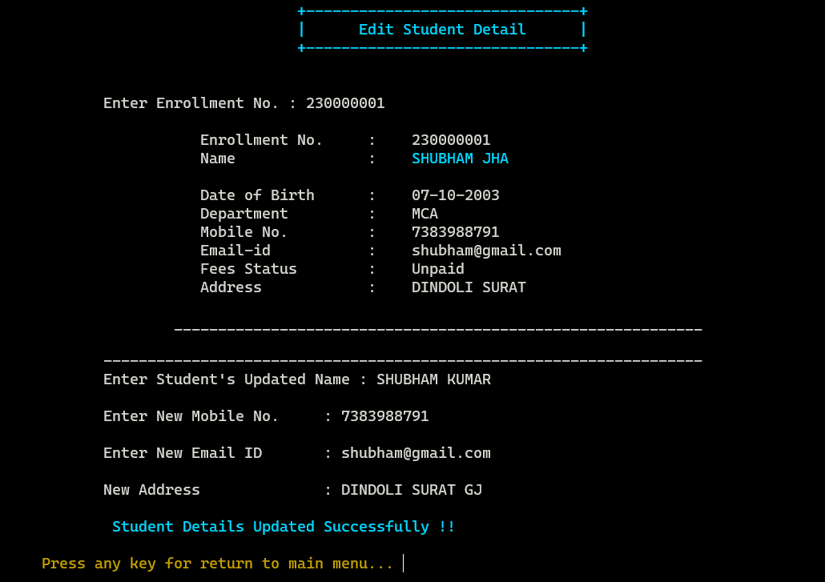
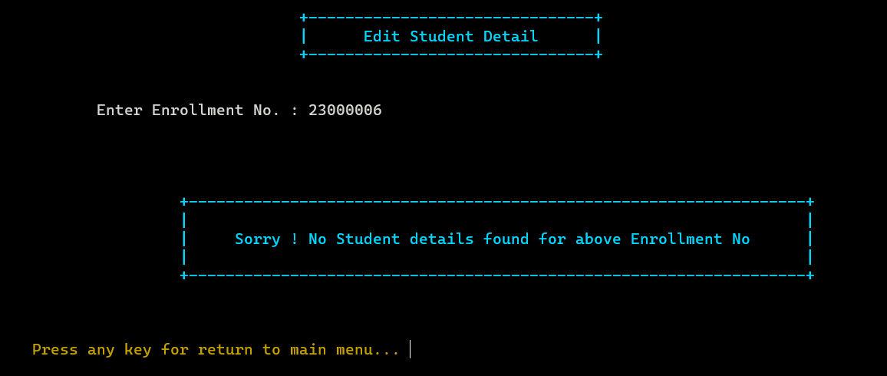
Screen Shorts

Slide 20
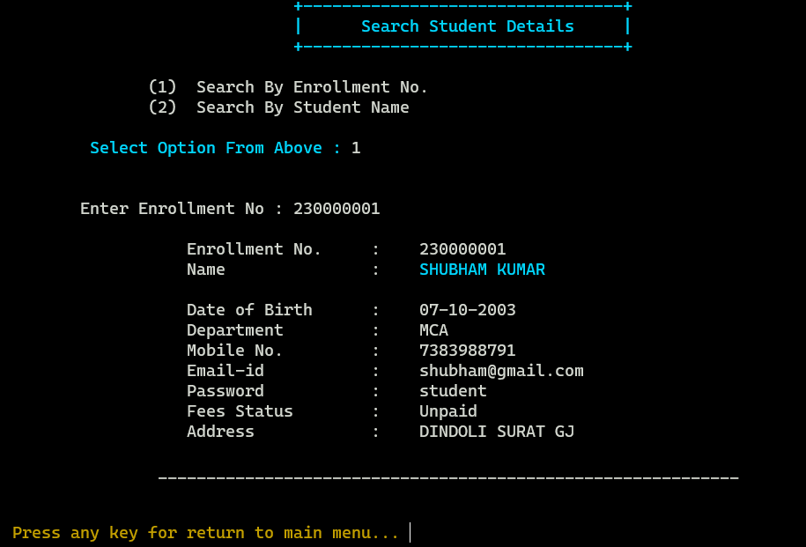
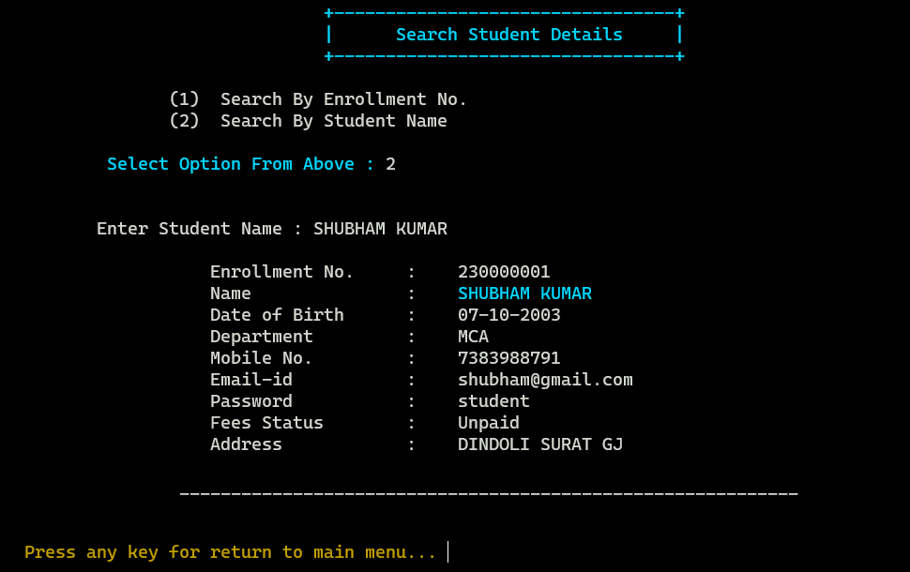
Screen Shorts

Slide 21
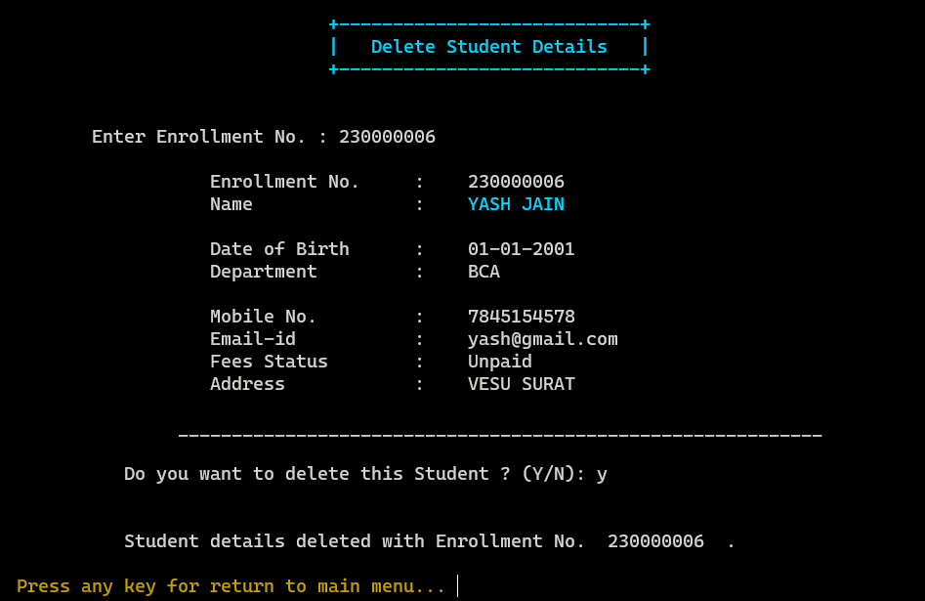
Screen Shorts

Slide 22
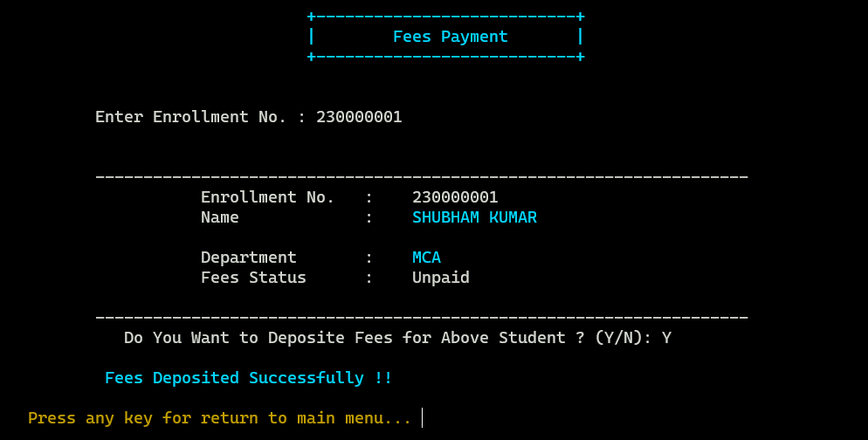
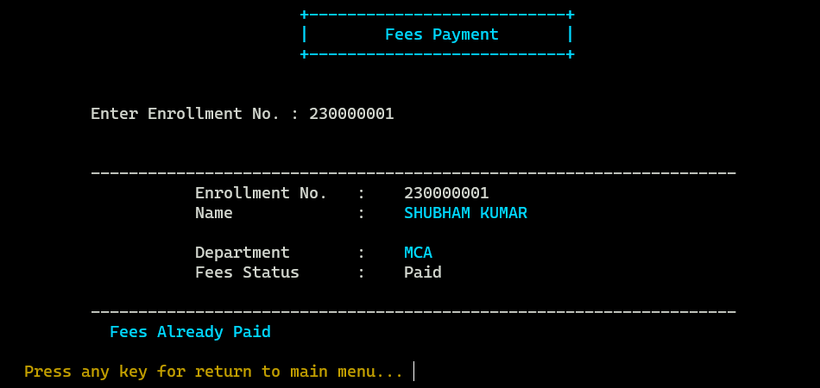
Screen Shorts

Slide 23
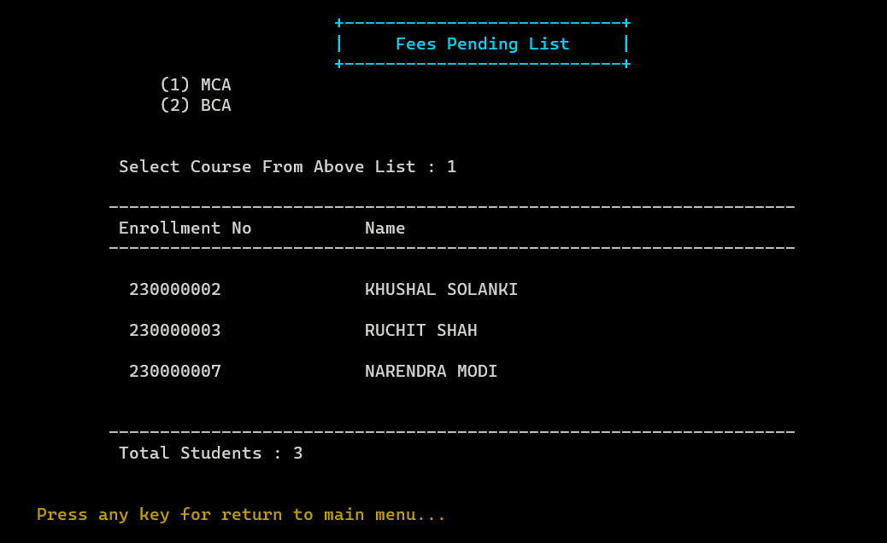
Screen Shorts

Slide 24
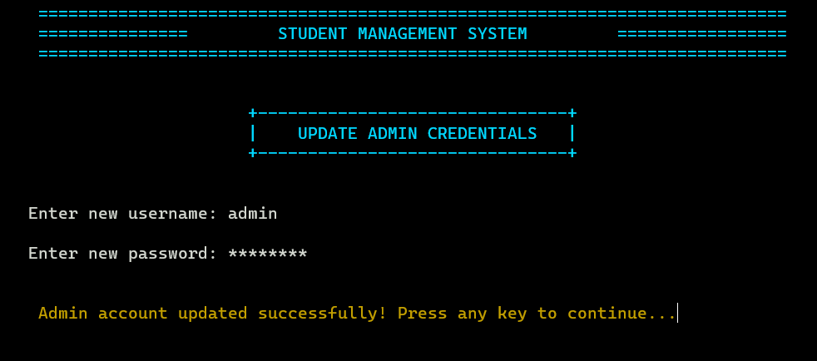
Screen Shorts

Slide 25
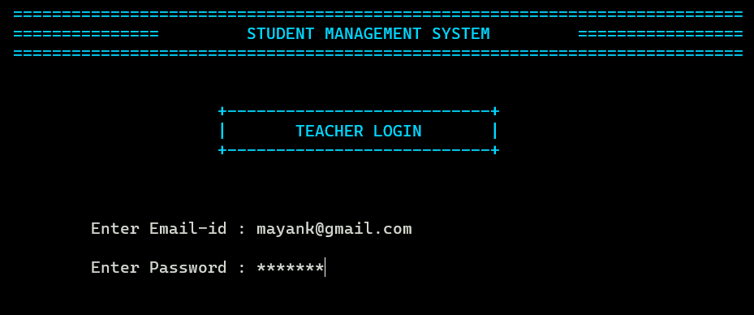
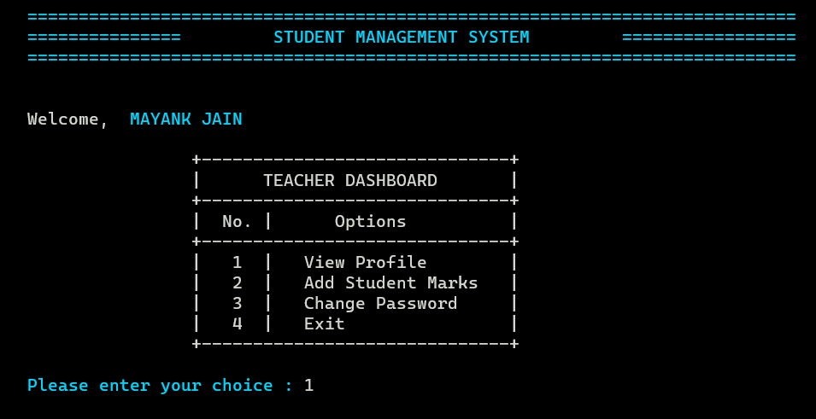
Screen Shorts

Slide 26
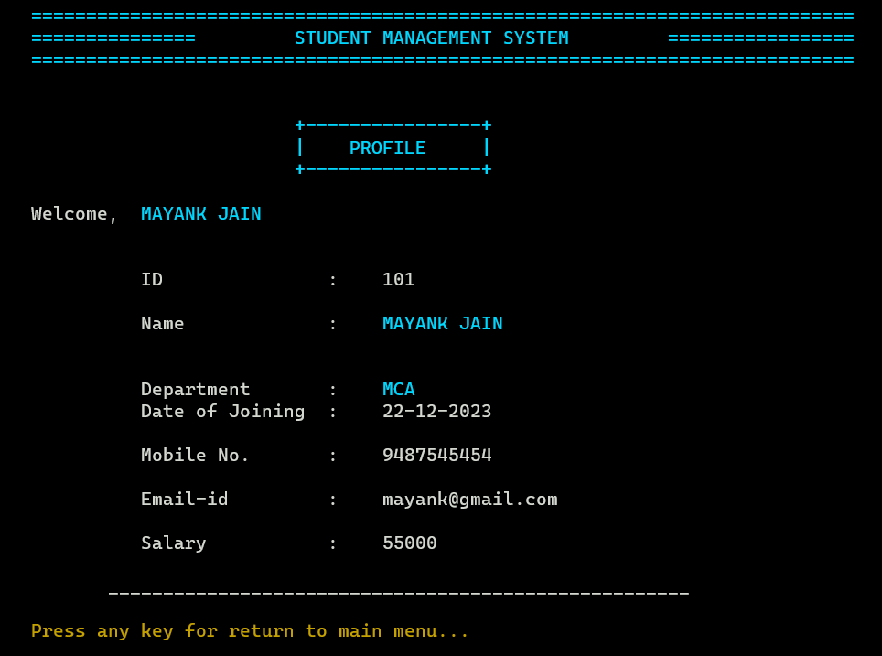
Screen Shorts

Slide 27
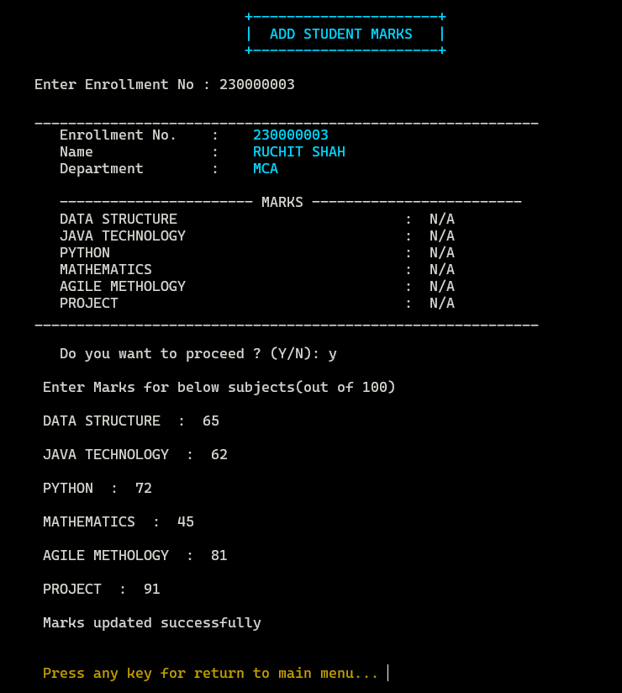
Screen Shorts

Slide 28
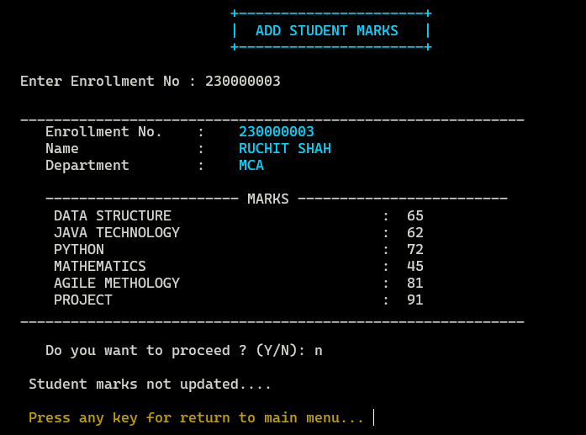
Screen Shorts

Slide 29
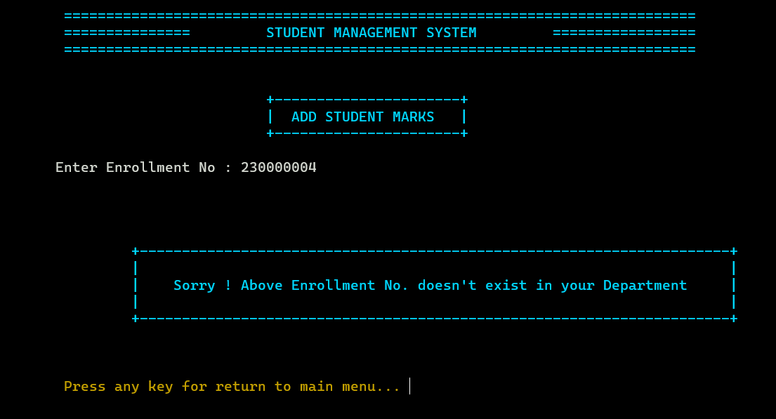
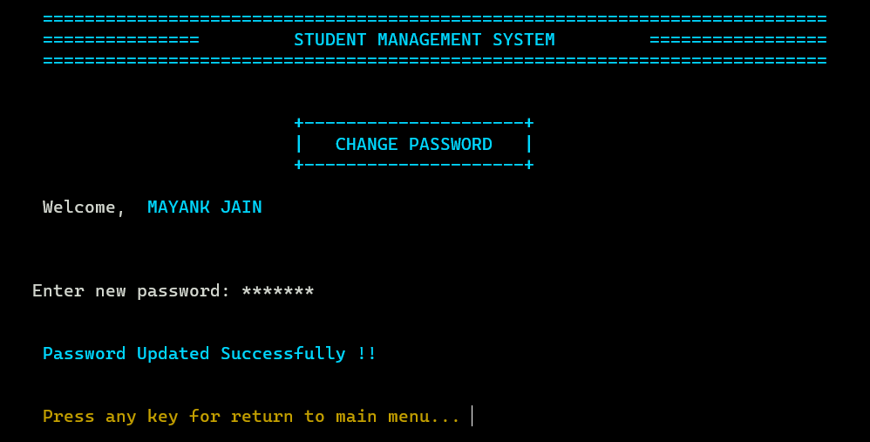
Screen Shorts

Slide 30
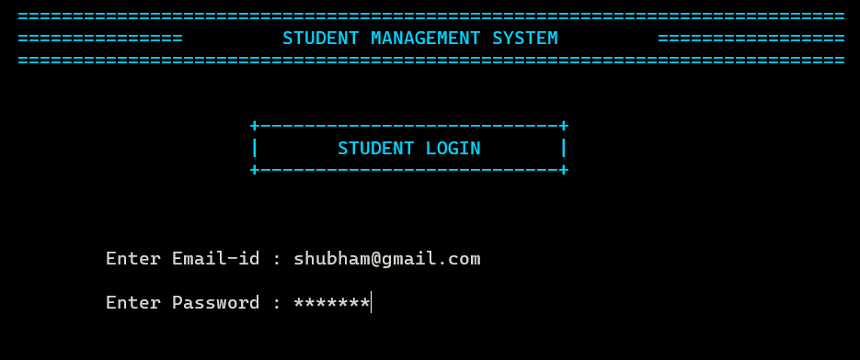
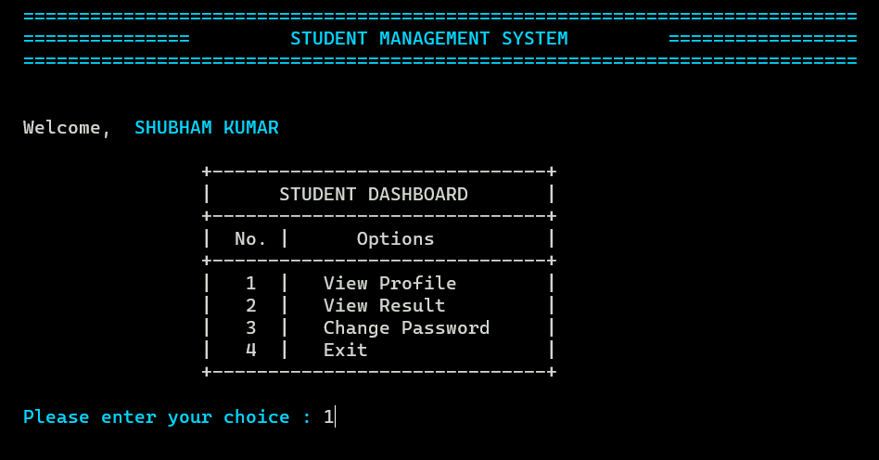
Screen Shorts

Slide 31
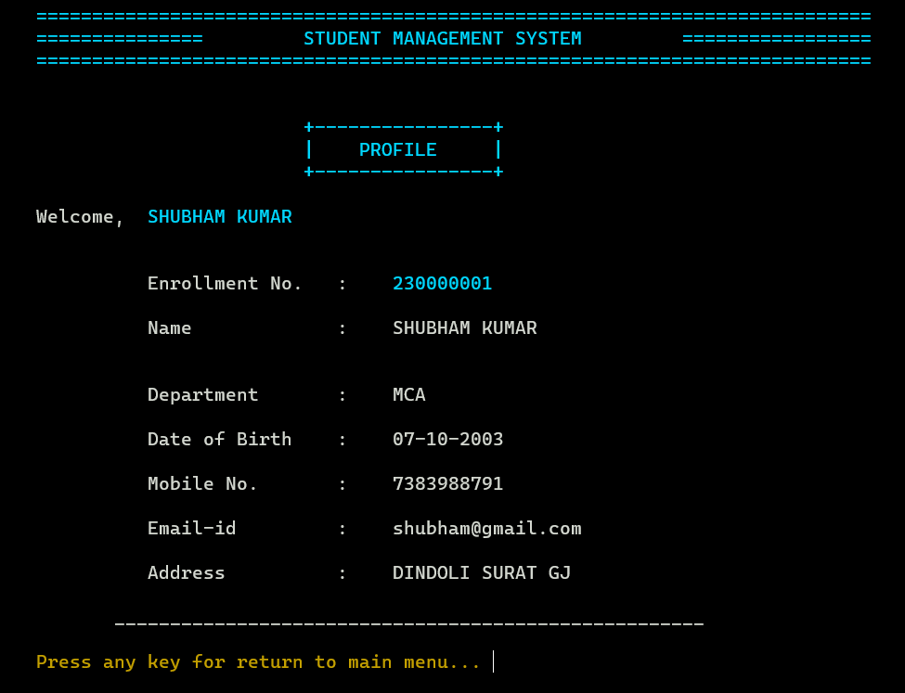
Screen Shorts

Slide 32
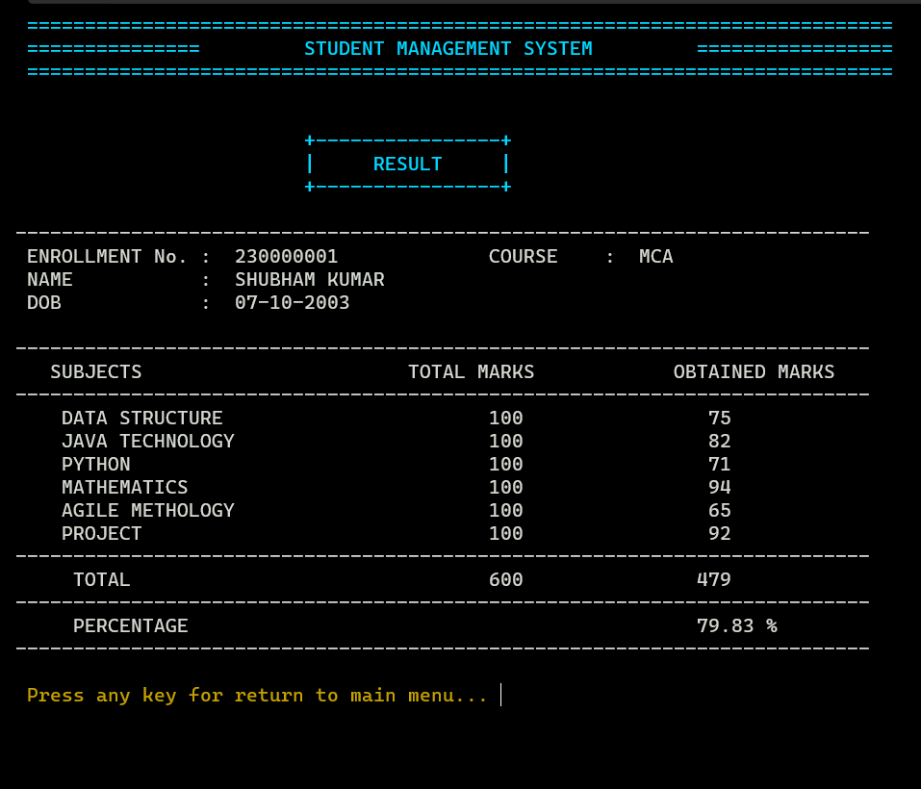
Screen Shorts

Slide 33
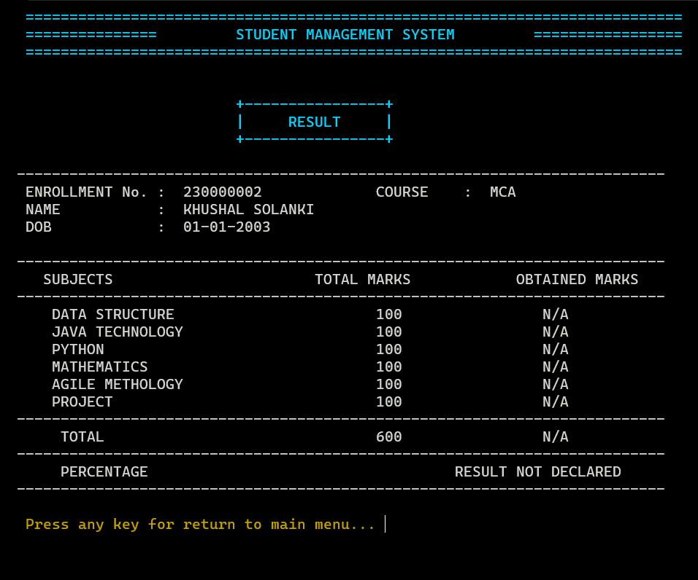
Screen Shorts

Slide 34
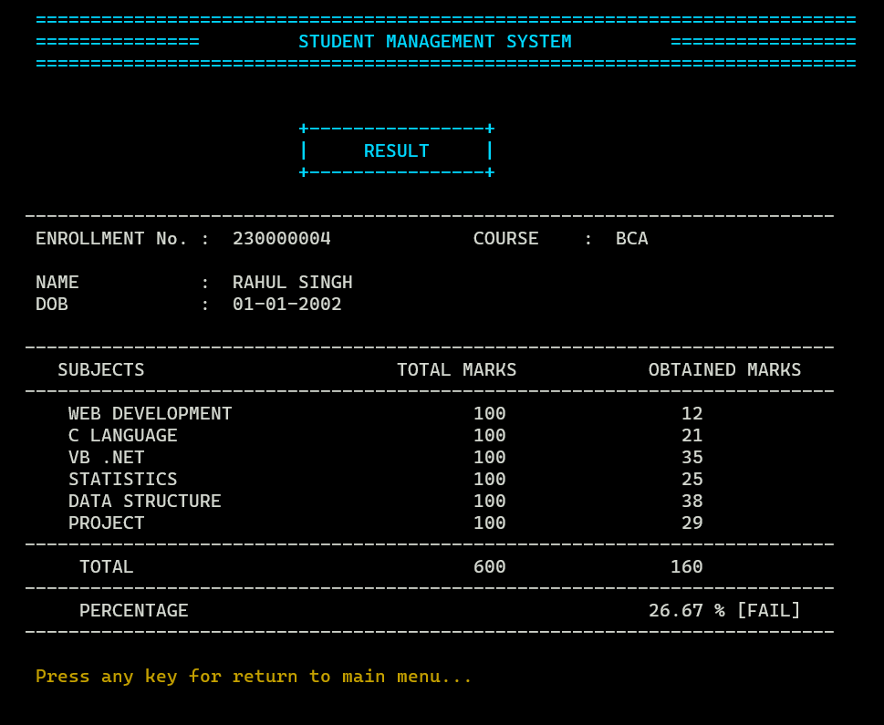
Screen Shorts

Slide 35
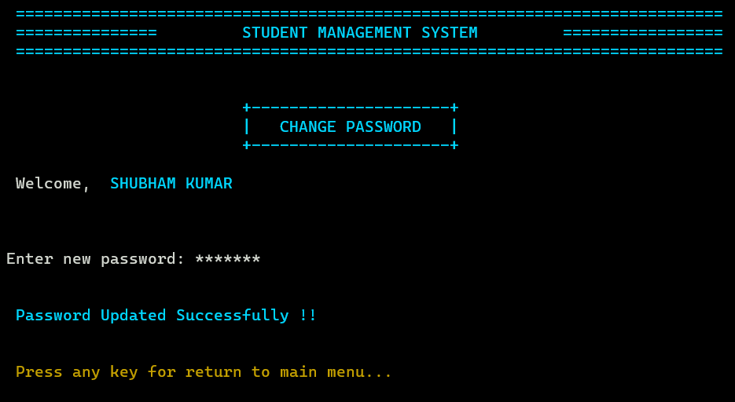
Screen Shorts

Slide 36
Limitations
User-Interface : Complex-user interface may lead to increased difficulty in acceptance of the student management application among the school staff. Absence of good internet facility :Good internet connectivity is another major issue that needs to be addressed. It is not actually a disadvantages of student management system but instead is necessary for its optimal functioning. User requirements : Whether the application will satisfy your expectations will depend on how useful it is in reducing the efforts of the teachers,students, etc.

Slide 37
References
https://www.cprogramming.com/ https://www.w3schools.com/c/index.php https://www.geeksforgeeks.org/c-programming-language/

Slide 38
Thank You

